Slide 1
DAO Week
Coursebook & Workbook Preview
📖🔭

Slide 2
What are Decentralised Autonomous Organizations (DAO)?
“A group chat with a bank account” - New York Times
How does it work? Who needs to be involved?
Can be configured for the needs of the organisation
Minimum proposal approval rate
Minimum participation validation (“quorum”)
Voting period, etc

Slide 3
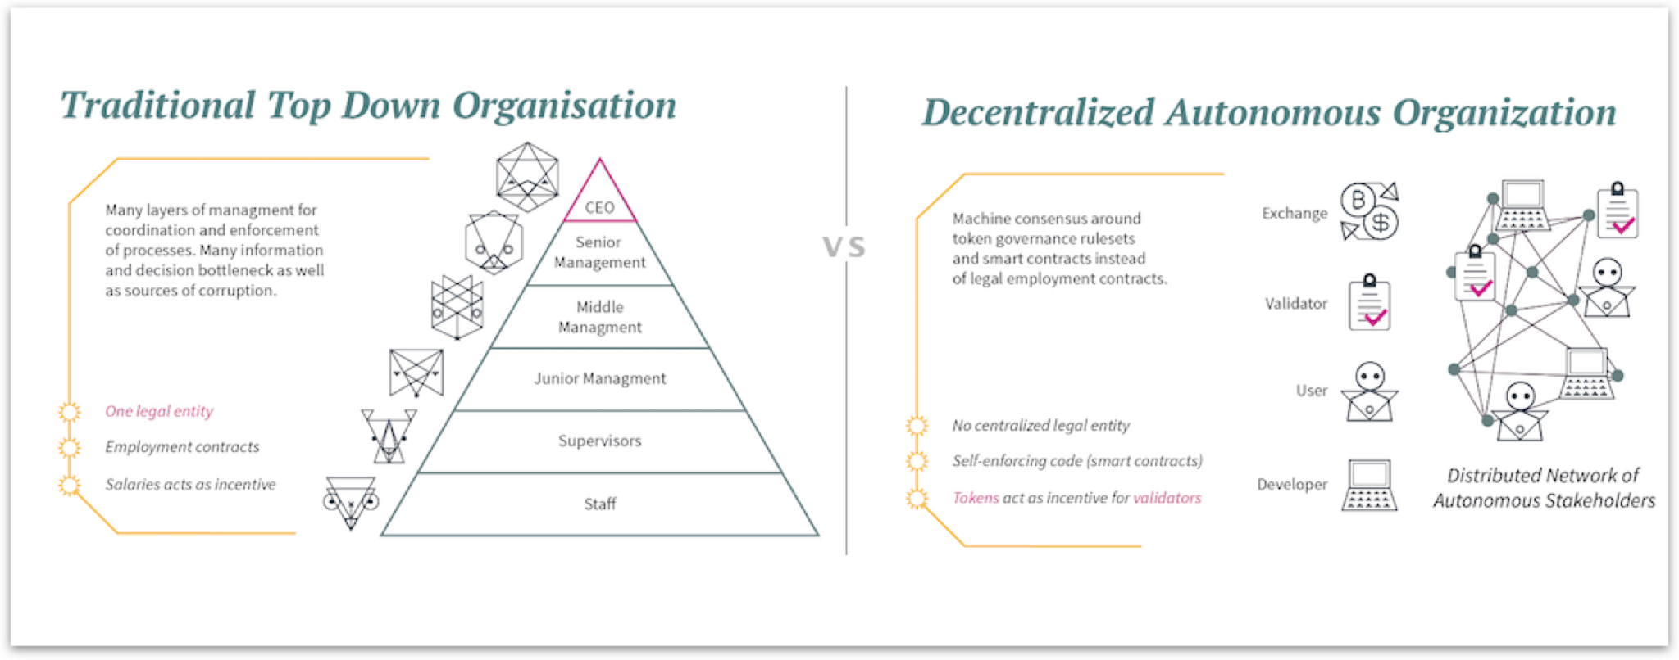
DAOs vs Companies
What are the similarities and differences?

Slide 4
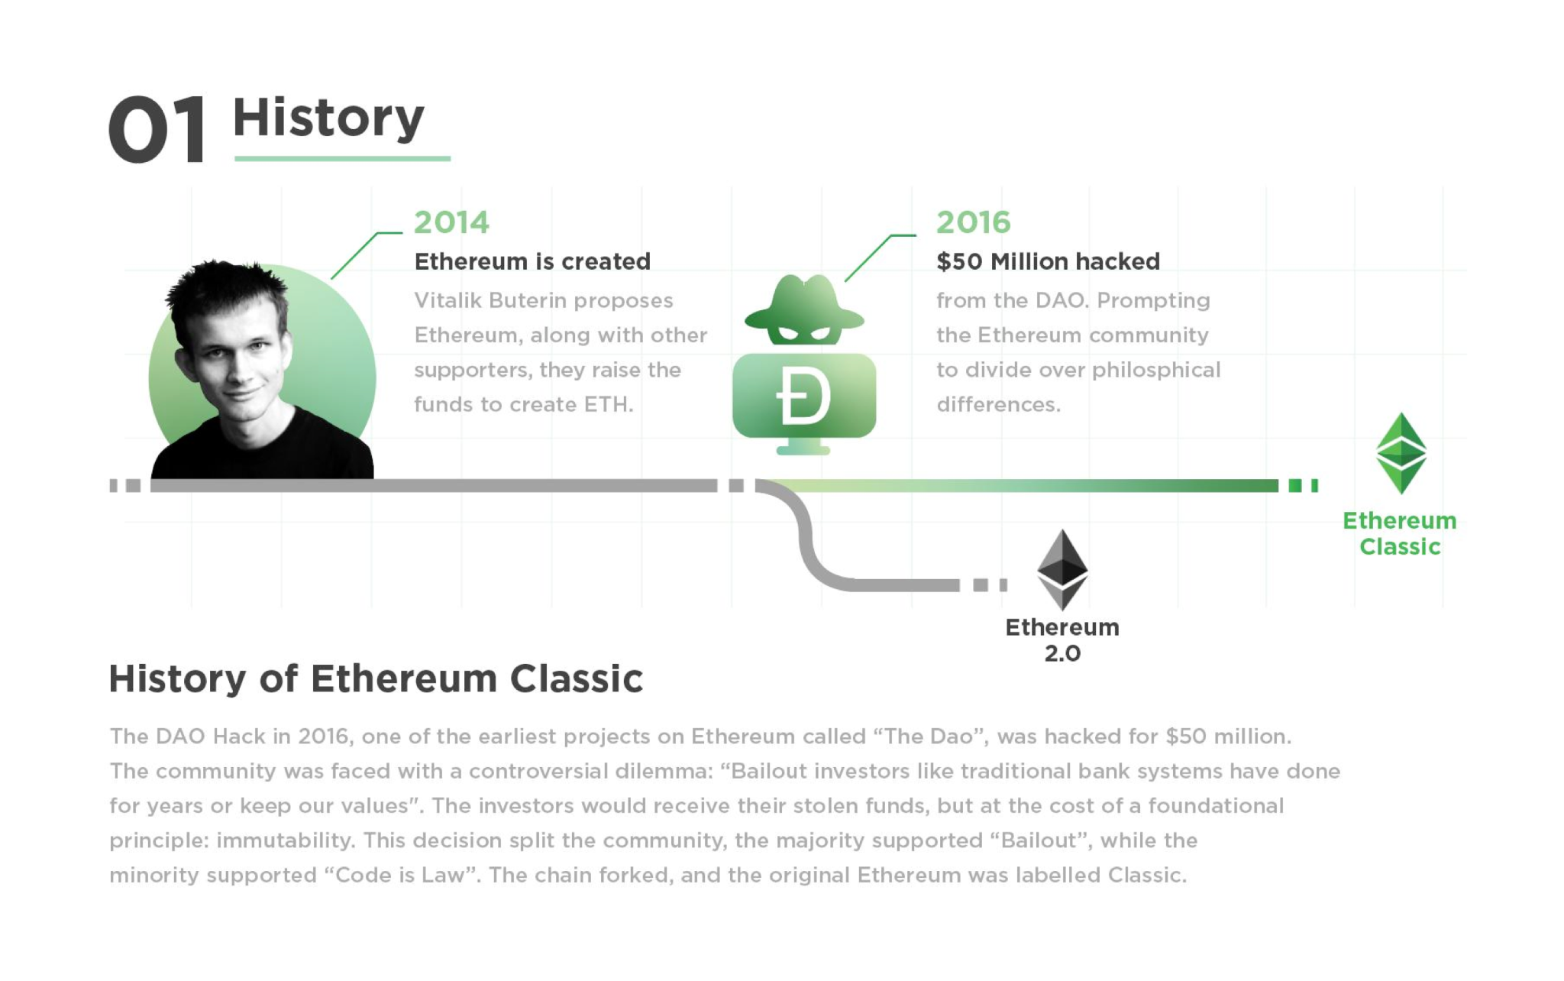
“The DAO” (... infamous)
A history lesson in Ethereum
14% of all ETH in supply stolen in hack
Resulted in the hard fork which created Ethereum (and the jilted Ethereum Classic)

Slide 5
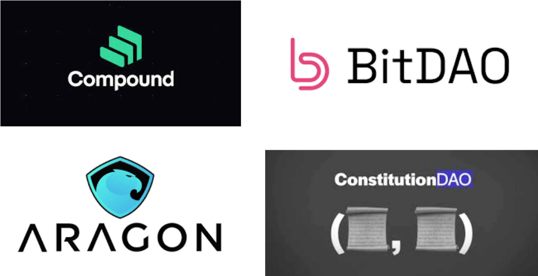
Other interesting DAOs

Slide 6
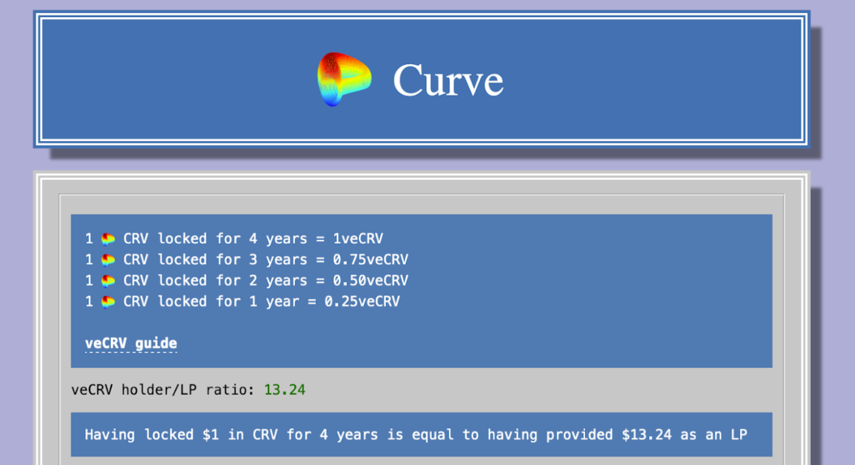
DAO Governance
DAO membership
Token-based
Share-based
Membership-based

Slide 7
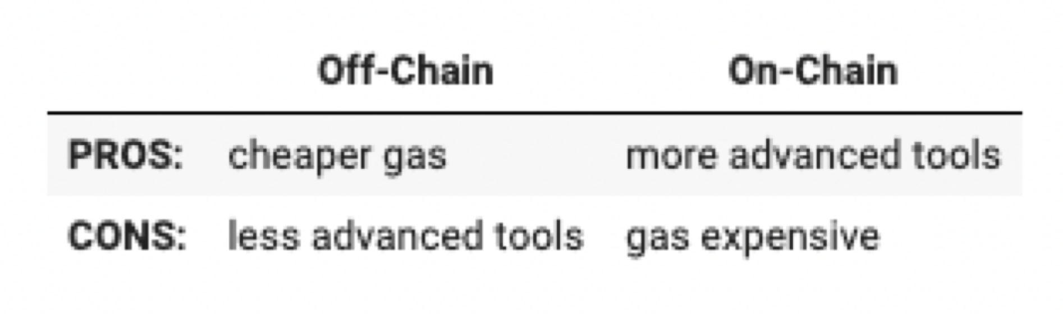
DAO Governance
Different types of voting
On-chain
Every user has to pay gas to vote
Off-chain
More susceptible to tamper

Slide 8
DAO Governance
Typical uses cases
How should the DAO’s balance be spent?
Should the code changes in the approval be implemented?

Slide 9
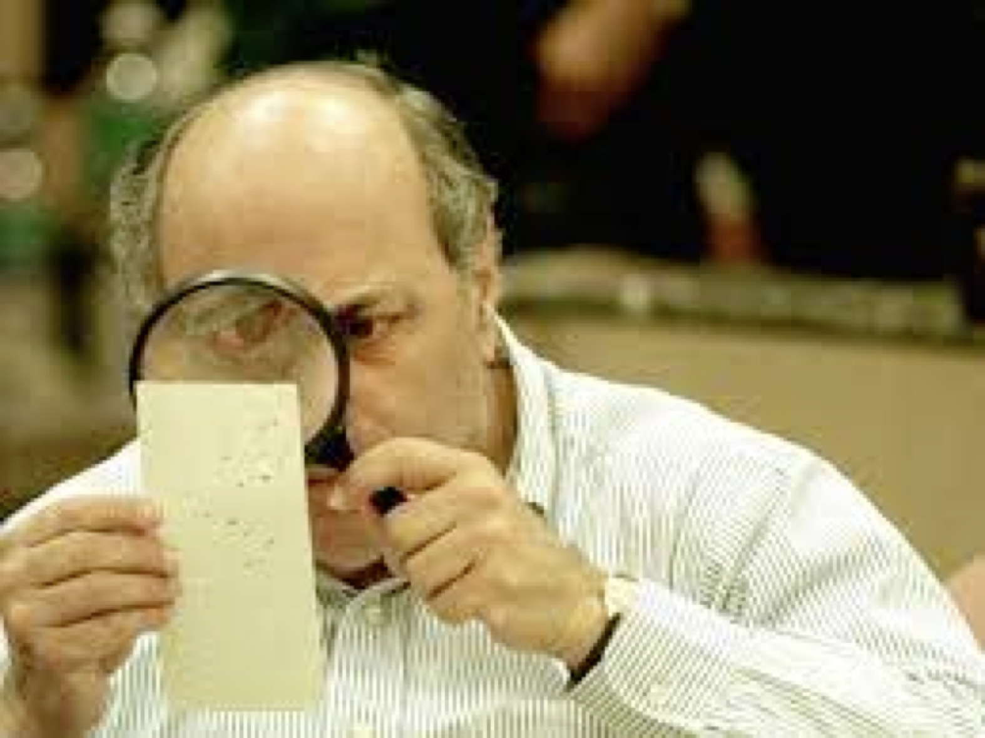
DAO Governance
Different types of voting:
Coin voting
Skin in the game
Proof of Personhood
Proof of humanity
Proof of participation
Quadratic voting

Slide 10
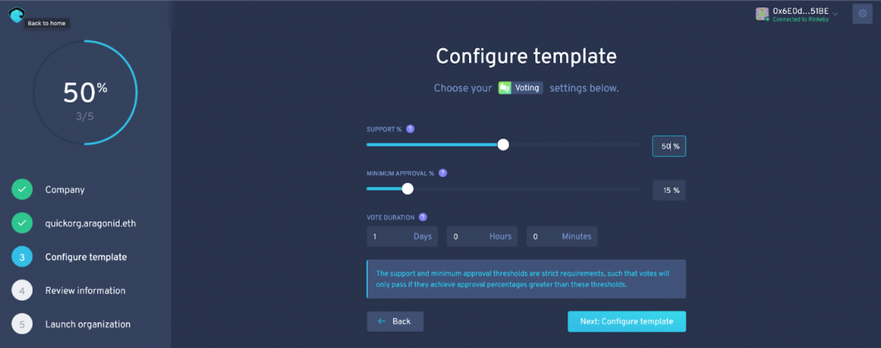
DAO Toolkits
Aragon - a protocol to create and deploy DAOs without any coding

Slide 11
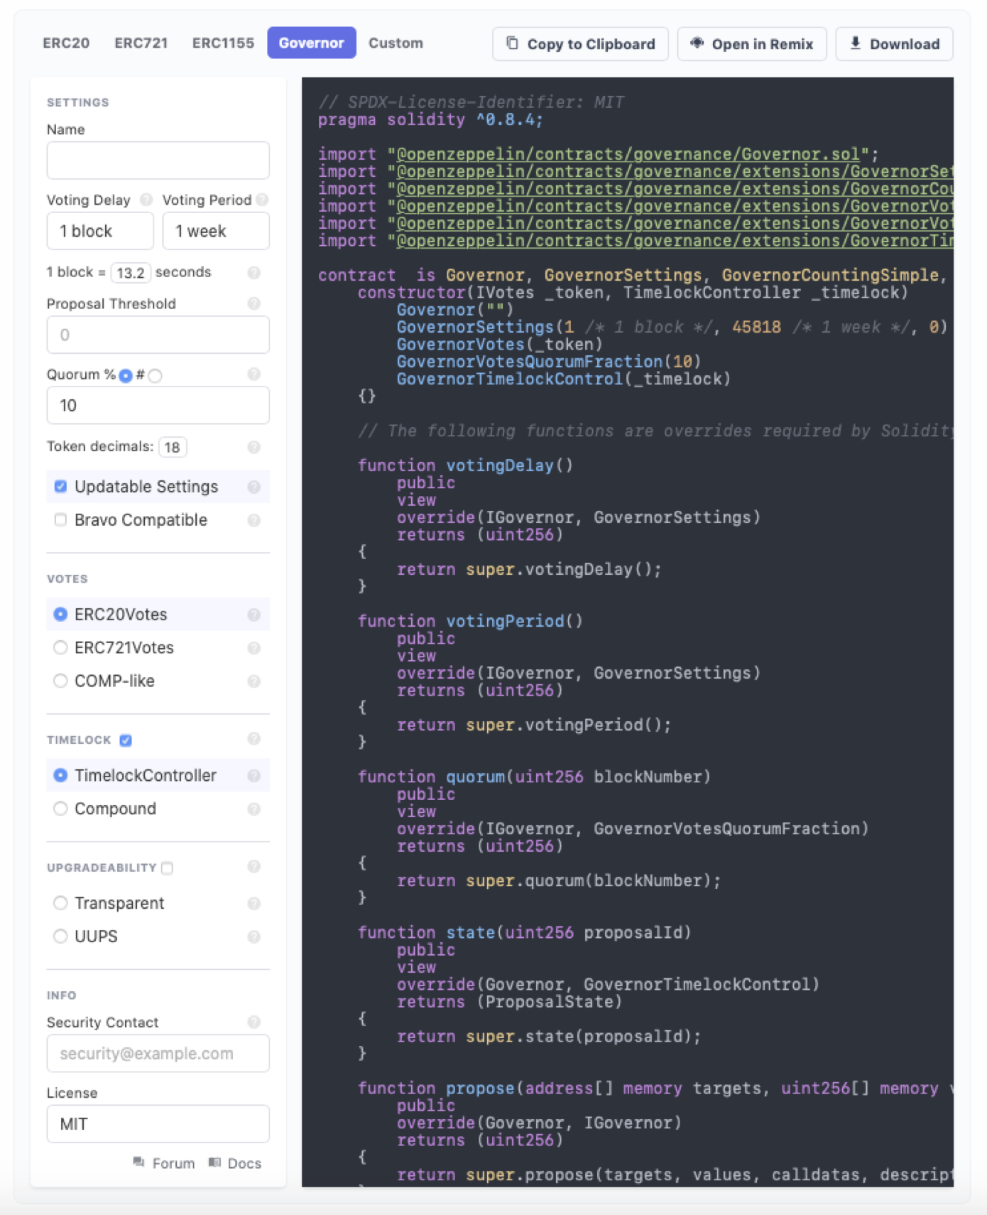
DAO Toolkits
Aragon - a protocol to create and deploy DAOs without any coding
DAO Stack
DAO Haus
Colon
OpenZeppelin Contract wizard

Slide 12
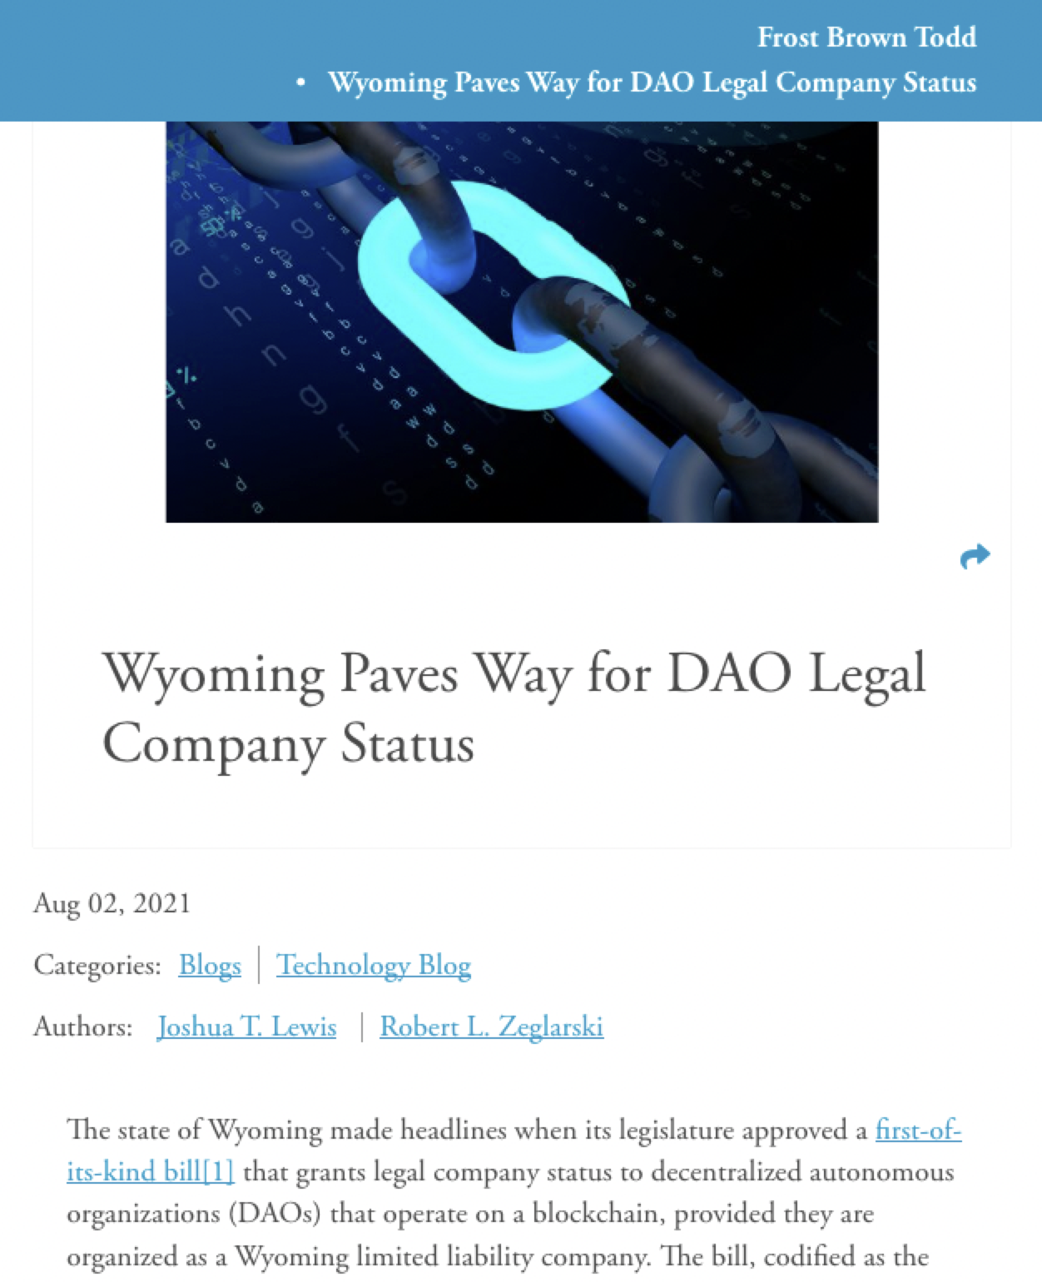
Legal Situation & Regulation
Learn about some instances of novel pieces of law being drawn up for DAOs
Wyoming state, DAO as LLC
“Entity selection framework” in US

Slide 13
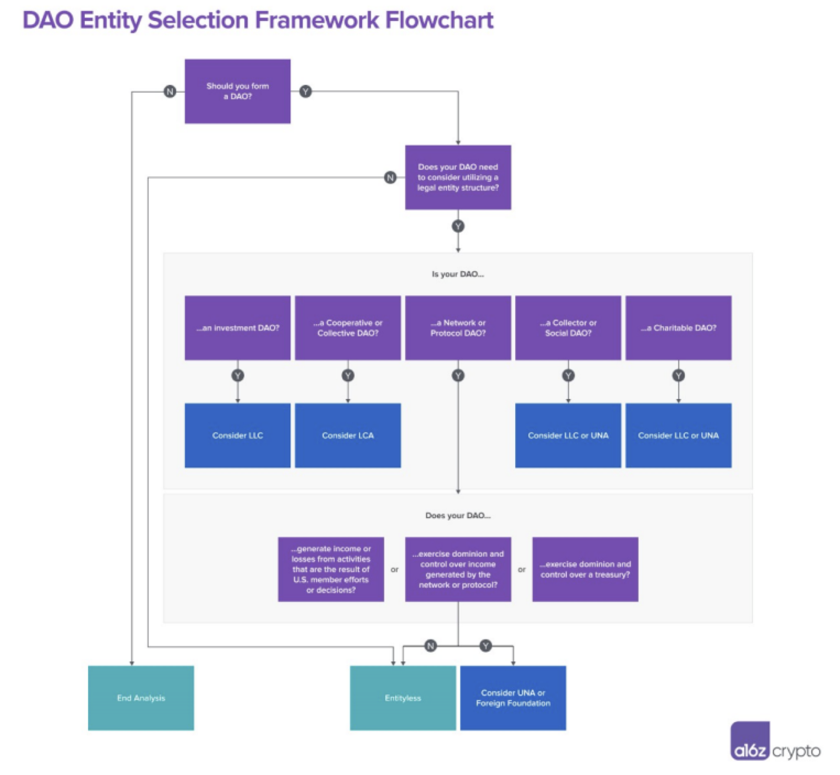
Legal Situation & Regulation

Slide 14
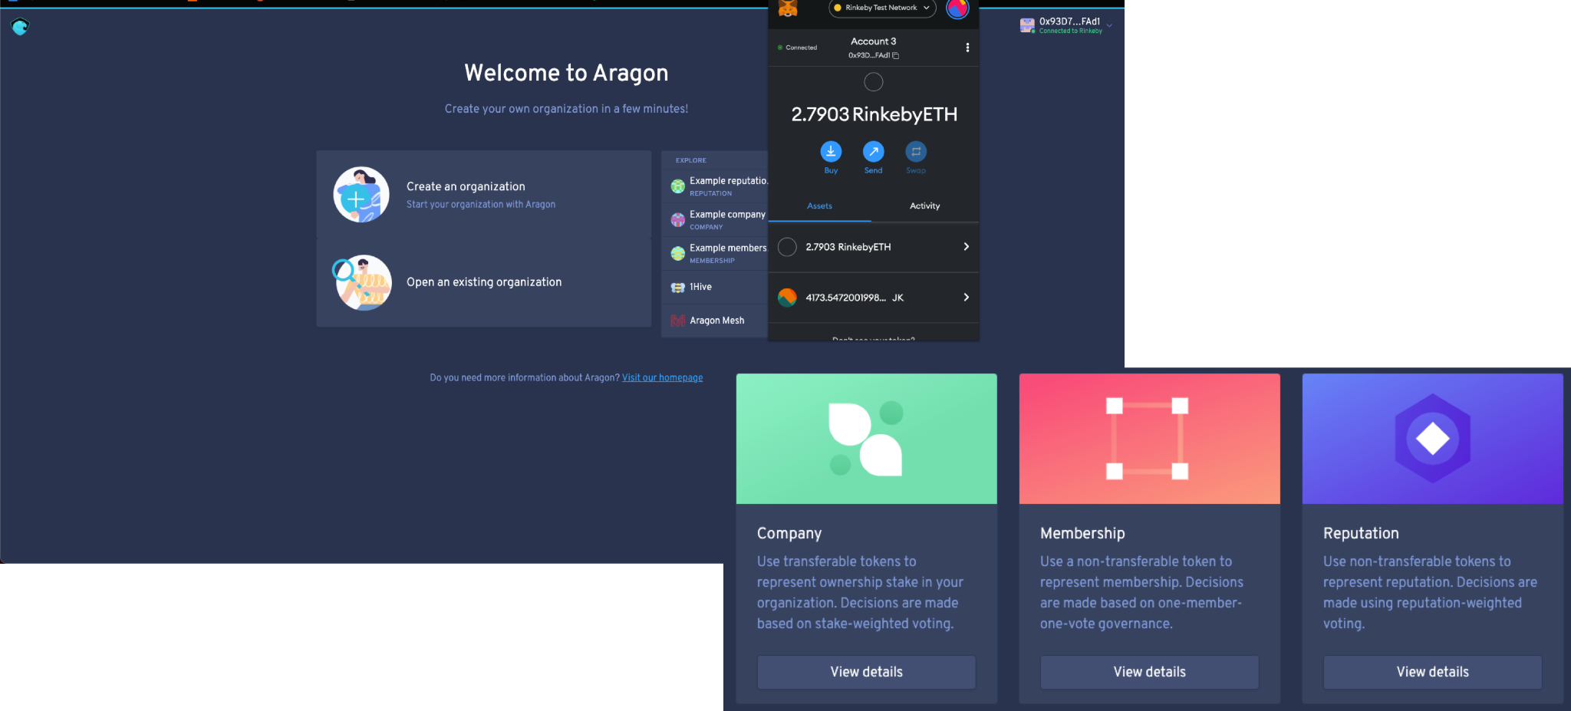
👩🏾‍💻 Assignment:
Create Your Own DAO using Aragon
Check its state and analytics using DeepDAOcoding

Slide 15

🚀 Final Bootcamp Project 🦾
Choose from:
Value Model
Application Model
Distribution Model
Economic Model

